Slide 1
Agenda
Class 12 – October 12th (10:30 – 12:30)
Starter Quiz
Security Architecture
Thought Paper Presentation
Consumer Persona’s (Micro and Small Business) – Banking Usage and Needs Analysis (Team 9) - 30 mins
Security Architecture (Cont’d)
Note:
Mobile Phones – Do not bring to class or Completely Switch off
If students have any specific topic they want to discuss, share the topic and we can try to schedule
Please be seated by your teams

Slide 2
Starter Quiz
What are the 5 Key Attributes of an Investment Category (i.e. attributes that should be assessed when doing an Investment)

Slide 3
5 Key Attributes
Risk
Return
Liquidity
Cash Flow
Taxation

Slide 4
Starter Quiz
Structural Shift of Wealth from West to East using some Data Metrics

Slide 5
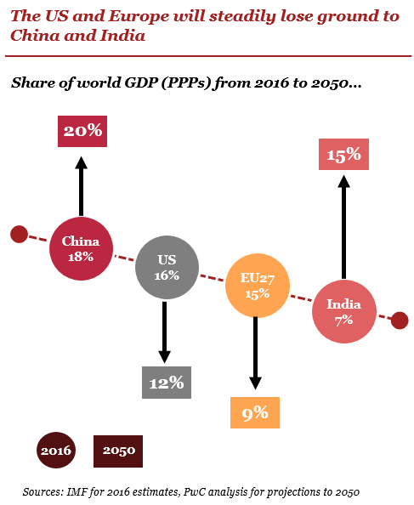
Structural Shift of Wealth from West to East – Some Data Metrics
Country / Region | 1980 (Nominal GDP) | 2025 (Nominal GDP) | 2050 (Nominal GDP)
EU | $3.3 Trillion | $19.9 Trillion | $28 Trillion
China | $302 Billion | $19.2 Trillion | $42 Trillion
Country / Region | 1990 (Nominal GDP) | 2025 (Nominal GDP) | 2050 (Nominal GDP)
UK | $1.15 Trillion | $3.8 Trillion | $5.3 Trillion
India | $320 Billion | $4.2 Trillion | $25 to $30 Trillion
Note: In 1600 China (29%) and India (23%) constituted 50% of World GDP

Slide 6
Core Banking Platform Engineering – Security Architecture

Slide 7
Security Architecture – Topics Covered
Authentication
Authorization
Encryption
Masking
Security Scanning and Testing
Industry Standards

Slide 8
Authentication

Slide 9

Authentication Overview
Identity Verification
Authentication ensures users are who they claim to be before accessing sensitive systems or data.
Common Authentication Methods
Passwords, biometrics, and multi-factor authentication are widely used to confirm user identities securely.
Importance
Strong authentication is essential for protecting sensitive data and preventing unauthorized access in digital environments.

Slide 10

Authentication – Single Factor and Multi Factor
Single Factor Authentication
Single factor authentication relies on one credential, usually a password, for identity verification. This method is simple but less secure.
Multi Factor Authentication
Multi factor authentication uses two or more factors, such as passwords, biometrics, or tokens, to enhance security and prevent unauthorized access.
Security Comparison
While single factor authentication is straightforward, multi factor offers stronger protection, especially for sensitive accounts and data.

Slide 11

Authentication Approaches
Multi-Factor Authentication
Multi-factor authentication uses a combination of factors such as passwords, devices, or biometrics to enhance security.
Biometric Authentication
Biometric authentication verifies identity with physical traits like fingerprints or facial recognition, offering enhanced convenience and security.
Passwordless Authentication
Passwordless authentication uses methods like one-time codes or push notifications for secure and user-friendly login experiences.

Slide 12

JWT Token
Secure Information Transmission
JWT (JSON Web Token) enables secure data exchange between parties by encapsulating information in a digitally signed JSON object.
User Authentication Process
After authentication, a JWT is generated and sent to the client, who uses it in future requests
Stateless Identify Verification
JWTs enable stateless authentication, allowing servers to verify user identity without storing session data.
JWT Structure: Header, Payload, Signature
Header: Token Information
The header identifies the type of token and the cryptographic algorithm used for signing, ensuring clear protocol and security.
Payload: Claims and Data
The payload contains the claims, which are statements about the user and additional data being securely transmitted.
Signature: Integrity Verification
The signature verifies the token's authenticity and integrity, ensuring it has not been tampered with during transmission.

Slide 13
Authorization

Slide 14
Role Based Authorization
Assigning Permissions by Role
Access permissions are granted based on user roles, making it easier to manage who can access specific resources.
Simplified Security Management
Grouping users and privileges by role streamlines security administration and reduces complexity in managing access.
Enhanced Data Protection
Users only access resources needed for their roles, which helps prevent unauthorized actions and minimizes data breach risks.

Slide 15
Maker-Checker Authorization
Dual Transaction Oversight
Maker initiates a transaction and checker reviews and approves it, ensuring thorough oversight and accountability.
Error and Fraud Reduction
The process minimizes errors and prevents fraud by requiring authorization from two individuals for each transaction.
Critical Industry Application
Commonly used in banking, specially for sensitive functions like Interest Rate Change or Product Config Changes etc..

Slide 16
Value Based Authorization
Attribute-Based Access Control
Value Based Authorization uses specific attributes such as Amount (e.g. Loan Amount or Transaction Amount) or location (e.g. when Branches are getting being closed or being sold) or Products (Special Products) or Customer Segments (e.g. VIP Customers like Royal Family) or Restricted Accounts (e.g. Owner has passed away) to grant access, not just user roles.
Fine-Grained Security
This method allows for detailed and precise control, ensuring users meet exact criteria before approval.
Real-Time Data Consideration
Real-time information such as Transaction Amount or Loan Amount can influence access decisions dynamically.

Slide 17
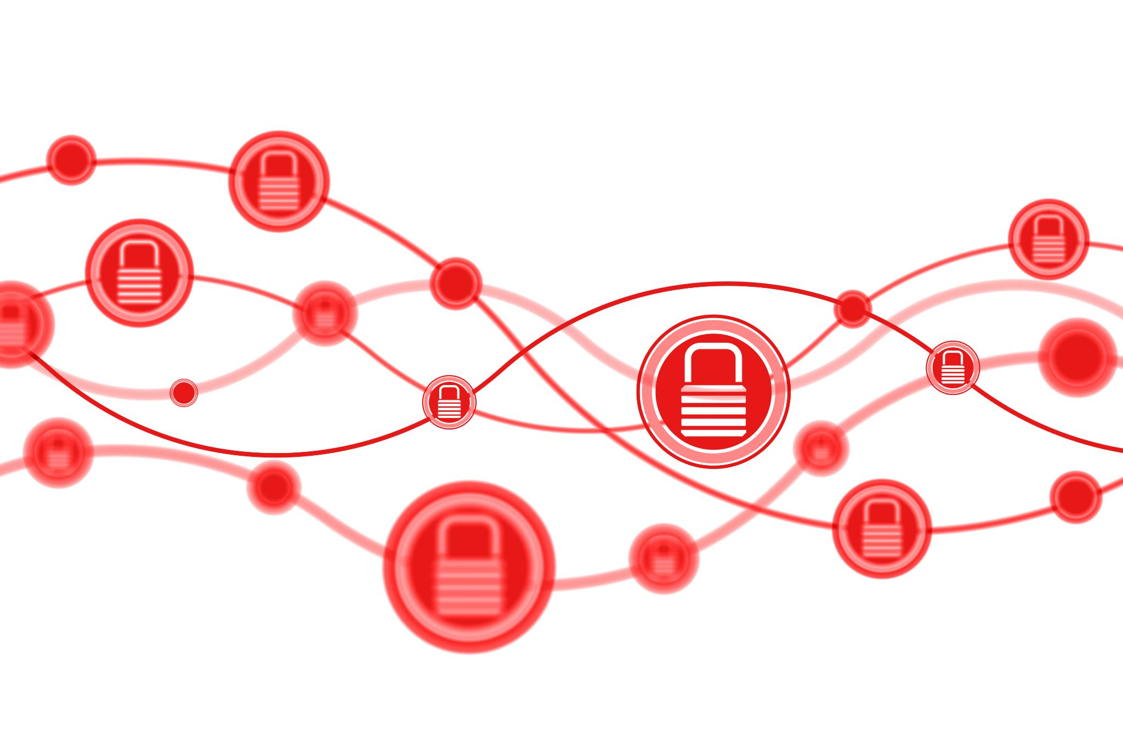
OAuth2 Protocol
Secure Authorization Standard
OAuth2 ('Open Authorization’) is an industry-standard protocol for authorization.
OAuth2 is designed to work with HTTP, making it ideal for securing API access.
Access Tokens and Permissions
OAuth2 uses access tokens to provide limited and controlled permissions, ensuring third-party apps only access necessary user data.
Enhanced Privacy and Security
By separating credentials from authorization, OAuth2 protects user privacy and strengthens platform security across various services.

Slide 18
JWT vs OAuth: Key Differences
JWT: Authentication Token
JWT is a compact, secure token format used for transmitting information between parties. It ensures data authenticity and integrity.
OAuth: Delegated Access Control
OAuth is an authorization protocol allowing users to grant access to resources without sharing their credentials.

Slide 19
Encryption

Slide 20
Encryption Overview
How Encryption Works
Encryption transforms readable data into an unreadable format, ensuring confidentiality and protecting information from unauthorized access.
Banking Usage
Encryption is vital for critical applications like Core Banking Platforms and is widely used for both “Data at REST” and “Data in Motion”
Compliance standards like PCI DSS require encryption of payment card data to prevent fraud and unauthorized access.
Encryption Methods
Encryption relies on complex algorithms and unique keys, making it highly effective against unauthorized access.
Notes:
information.

Slide 21

Encryption Types
Symmetric Encryption
Symmetric encryption uses one key for both encrypting and decrypting data. offering faster performance but risks if the key is exposed.
AES is an example of Symmetric Encryption.
Asymmetric Encryption
Asymmetric encryption relies on a public key for encrypting data and a private key for decrypting it securely. Enables secure communication over open networks and improves security by avoiding key sharing.
Algorithms like RSA and ECC use complex mathematics to generate secure key pairs for encryption.
Only the intended recipient with the private key can access encrypted information, preventing unauthorized data exposure.

Slide 22

Encryption: Rest and Motion
Encryption at Rest
Encryption at rest protects sensitive information stored on databases, files (Disks) from unauthorized access and ensures data remains confidential.
Encryption in Motion
Encryption in motion safeguards data as it moves across networks, preventing interception or tampering during transmission.
Comprehensive Data Security
Using both encryption methods is essential for data security and regulatory compliance.

Slide 23
Data in Motion – API Encryption
Protecting Data in Motion
Encryption secures sensitive information as it travels between clients and servers, shielding it from interception and theft.
API Gateway
The API Gateway manages encryption, authentication, and rate limiting for both external and internal clients.
Protecting API Headers
Encrypting API headers shields sensitive metadata such as authentication tokens from interception.
Securing Data Payloads
Encrypting the payload prevents unauthorized access and preserves data integrity throughout API communications.
Notes:
.

Slide 24
Data in Motion – Event Encryption
Protecting Transmitted Data
Encryption secures event data as it travels across networks, maintaining confidentiality and preventing unauthorized access.
Ensuring Confidentiality and Integrity
Readable events are converted to unreadable formats, making them accessible only to authorized recipients and preventing tampering.
Event Header Encryption
Event headers often hold metadata and may be partially encrypted to hide crucial information from unauthorized access.
Event Payload Encryption
Event payloads contain core data and are fully encrypted, ensuring confidentiality and protection from data breaches.
.
Notes:
.

Slide 25
Data at REST - TDE Encryption for Database
Protection of Data at REST
TDE is used for Database Encryption, ensuring information stored in the database remains secure and inaccessible to unauthorized users.
Seamless Real-Time Encryption
Data and log files are encrypted in real-time without the need for application modifications, simplifying deployment.
Master Key and Certificates
TDE leverages a master key and certificates to manage encryption, ensuring compliance and enhancing security protocols.

Slide 26

TDE Challenges
Managing Performance Overhead
TDE introduces real-time encryption and decryption, which may affect system performance and require optimization.
Secure Key Management
Handling encryption keys securely demands robust policies and specialized tools to protect sensitive data.
Addressing Compatibility Issues
Backup, restore, and migration can encounter compatibility issues, requiring thorough planning and testing.

Slide 27

Column Level Encryption
Protecting Sensitive Fields
Column encryption secures confidential data by encrypting only specific fields, reducing unnecessary exposure and enhancing privacy.
Granular Access Control
Authorized users are granted access to encrypted columns, providing precise control over who can view sensitive information.

Slide 28

TDE vs Column Encryption
Transparent Data Encryption
TDE encrypts the entire database at rest, safeguarding backups and logs with minimal application changes.
Column Level Encryption
Column Encryption secures specific sensitive fields, offering detailed protection during processing and data transfer.
Choosing the Right Approach
The choice depends on compliance, performance needs, and application complexity, balancing security and efficiency.

Slide 29

Data at REST - File Encryption
What is File Encryption
File encryption is the process of converting data into unreadable format using a mathematical algorithm (a cipher) to prevent unauthorized access. To access the original information, the "ciphertext" must be decrypted with a unique "key". This process protects sensitive information when files are at rest (or even in transit i.e. when exchanging Files across Networks).
Privacy and Security Benefits
File encryption secures sensitive information, preventing unauthorized access and data breaches.
Major File Encryption Tools
Enterprise file encryption tools include solutions like Symantec Encryption & VeraCrypt, they offer AES 256 encryption. .

Slide 30

Encryption General Challenges
Balancing Security and Performance
Encryption can introduce latency, impacting performance especially in real-time processing systems.
Key Management Complexity
Securely storing, rotating, and distributing encryption keys demands robust infrastructure and strict policies.
Legacy System Integration
Integrating encryption with outdated architectures (specially with Corebanking where many banks run on Older Platforms) poses compatibility and support challenges

Slide 31
Data Masking

Slide 32

Data Masking
Obscuring Sensitive Information
Data masking transforms confidential data, making it unreadable to unauthorized users and enhancing security.
Common Masking Examples
Masking is used to obscure account numbers, credit card numbers, anonymize names, and hide email addresses in test environments or when sending customer communications or in Reports.

Slide 33
Why Data Masking
Protecting Sensitive Data
Data masking secures private information in testing and development, reducing the risk of exposure in non-production environments.
Regulatory Compliance
Complying with regulations like GDPR and HIPAA is crucial, making data masking a legal necessity for personal and financial data.
Preventing Unauthorized Access
Obscuring identifiable data in reports and analytics reduces the chances of unauthorized access or misuse by internal or external actors.

Slide 34
Types of Data Masking
Static Data Masking
Static Data Masking creates a copy of data and replaces sensitive info with realistic fake data for testing environments.
Dynamic Data Masking
Dynamic Data Masking masks data in real-time based on user roles to restrict sensitive data access dynamically.
Notes:
--- This slide references information from the following file: https://lakshmanagandhicaboglobal-my.sharepoint.com/personal/venu_madhav_icaboglobal_com/Documents/Desktop/MIT-MAHE/Banking%20Tech%20Course/Class%208%20to%2010/Class%209/Class%209%20-%20Core%20Banking%20Platform%20Engineering%20-%20Key%20Application%20Design%20Principles.pptx?web=1,https://lakshmanagandhicaboglobal-my.sharepoint.com/personal/lakshmana_gandh_icaboglobal_com/_layouts/15/Doc.aspx?sourcedoc=%7B65F7FD46-24A3-4E89-8CCF-D158B166B290%7D&file=Technology%20Stack%20Selection%20for%20iCABO%201.pptx&action=edit&mobileredirect=true&DefaultItemOpen=1 There are several types of data masking techniques, each suited to different use cases and security requirements. Static Data Masking (SDM) involves creating a copy of the original data and replacing sensitive information with fake but realistic data. This is commonly used in non-production environments such as testing and development. Dynamic Data Masking (DDM), on the other hand, masks data in real-time based on user roles and permissions, ensuring that only authorized users can view sensitive information. Tokenization replaces sensitive data with non-sensitive placeholders or tokens that cannot be reverse-engineered without special access. These tokens are used in applications in place of the original data, enhancing security while maintaining functionality. Each of these methods plays a vital role in protecting data across various operational contexts, and their implementation depends on the specific needs of the organization.

Slide 35
Data Masking Methods
Substitution Method
Substitution replaces sensitive information with fictional but realistic values, preserving data format while protecting privacy.
Shuffling Technique
Shuffling randomly reorders data within a set, making it harder to link information to real individuals.
Character Scrambling
Character scrambling mixes up characters within data fields, preventing easy identification of the original information.

Slide 36
Security Scanning and Testing

Slide 37
Why Security Testing Matters in Core Banking
Protect Sensitive Financial Data
Security testing protects sensitive financial data from breaches and fraud, preserving customer trust and bank integrity.
Validate Security Mechanisms
Testing verifies authentication, encryption, and access controls to ensure banking infrastructure resilience against threats.
Identify and Mitigate Vulnerabilities
Security testing uncovers vulnerabilities early, allowing mitigation before exploitation to safeguard reputation and stability.
Ensure Compliance and Continuity
Testing supports regulatory compliance and operational continuity amidst growing cyber threats and digital transformation.

Slide 38
Types of Security Testing
Static Application Security Testing (SAST)
SAST analyzes source code to detect vulnerabilities without running the software, ensuring early flaw detection.
Three Major SAST Scanning
Dynamic Application Security Testing (DAST)
DAST tests running applications to identify security issues during execution, detecting runtime vulnerabilities.
Penetration Testing
Simulates real-world cyberattacks to uncover exploitable weaknesses and improve system defenses.
Compliance
compliance testing ensures regulatory adherence like PCI DSS and GDPR.
Application Scanning
Open Source Scanning
Container Scanning

Slide 39

SAST – Application Scanning
Early Vulnerability Detection
SAST tools analyze source code to identify security vulnerabilities at the start of development, minimizing risks later.
Cost-Efficient Remediation
Addressing issues early with SAST reduces the cost and effort required to fix security flaws after deployment.
Continuous Integration Security
SAST tools integrate seamlessly into CI/CD pipelines, providing constant code scanning for ongoing security maintenance.
Secure Coding Standards
SAST promotes adherence to secure coding standards, helping teams maintain consistent and secure development practices.
Major SAST – Application Scanning Tools
Veracode, Checkmarx are some of the major SAST Application Scanning Tools used for Enterprise Products/Platforms

Slide 40
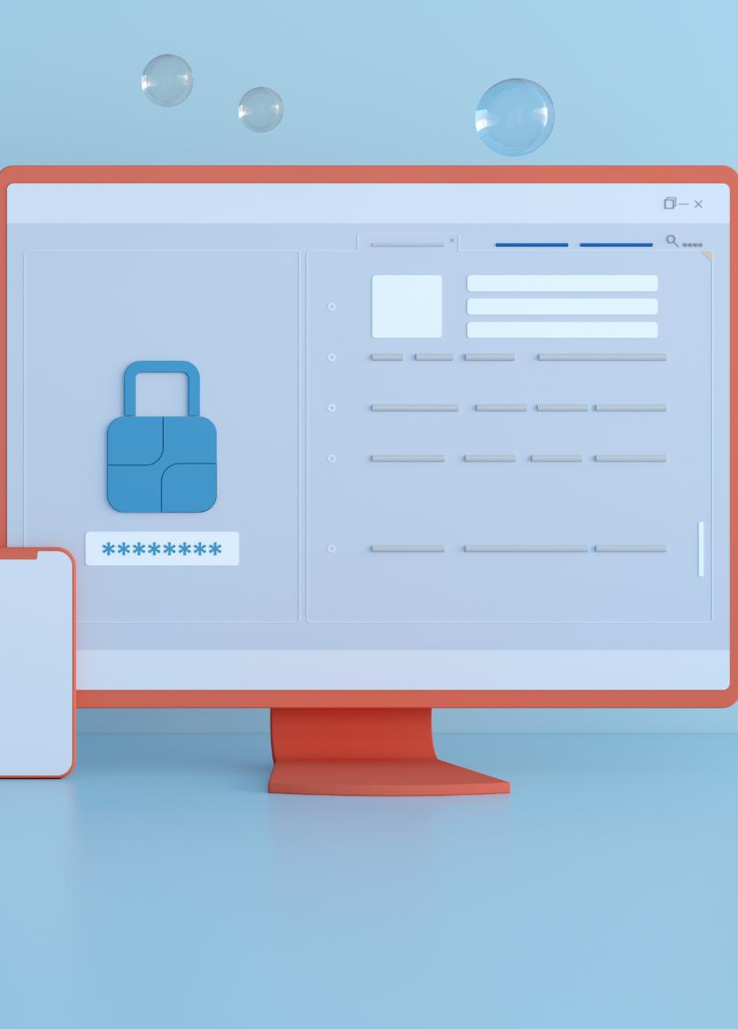
SAST - OSS Scanning
Detection of Vulnerabilities
OSS scanning identifies security vulnerabilities in open-source software components, helping teams address risks early in the development process.
Ensuring License Compliance
Assess license requirements of software packages, ensuring projects maintain legal compliance during development and deployment.
Major SAST – OSS Scanning Tools
Blackduck, Synk are some of the major SAST Tools used for Enterprise Products/Platforms

Slide 41
SAST - Containers Scanning
Vulnerability Detection
Security scanning finds vulnerabilities in container images before deployment, helping prevent exploits and attacks in production.
Automated Security Checks and Continuous Image Analysis
Automated tools identify outdated components, misconfigurations, and known flaws to ensure secure container builds.
Major Container Scanning Tools
Top container scanning tools include Sysdig Secure, Docker Scout that provide comprehensive security and runtime protection, often suited for large enterprises and DevOps

Slide 42

Embedding SAST in CI-CD
Early Vulnerability Detection
Integrating SAST in CI-CD enables teams to find and fix vulnerabilities during the development process, not after deployment.
Automated Security Scans
Automated SAST scans in CI-CD pipelines quickly identify code issues, improving software quality and developer efficiency.
Continuous Developer Feedback
Sprint retrospectives review testing metrics to foster ongoing improvements in security and software quality.

Slide 43
SAST Implementation Challenges
Workflow Integration
Integrating SAST tools into established development workflows and Pipelines can be difficult and may slow release cycles.
Managing False Positives
SAST tools often produce false positives, making it challenging for teams to priorities and address real security issues.
Adapting to Evolving Codebases
Rapidly changing codebases and new programming languages can reduce the effectiveness of SAST solutions.

Slide 44

DAST Overview
Analyzing Live Applications
DAST tools test running applications to find security flaws, simulating real-world attacks without reviewing source code.
Language-Agnostic Testing
DAST tools work across different programming languages, as they do not require access to the application's underlying source code.
Detecting Runtime Threats
DAST helps identify issues like SQL injection and cross-site scripting, reducing security risks in operational environments.
Major DAST Tools
Veracode Dynamic Analysis, Checkmarx DAST, Blackduck are some of the major SAST Tools used for Enterprise Products/Platforms

Slide 45

Penetration (PEN) Testing
Simulating Cyberattacks
Penetration testing simulates real cyberattacks to uncover potential vulnerabilities in IT systems and infrastructure.
Identifying Security Weaknesses
Organizations identify and understand security weaknesses before attackers can exploit them, reducing risks.
Improving Security Defences
Penetration tests offer actionable recommendations to strengthen security across networks, applications, and sensitive data.
Specialized Certification Team / 3rd Party Certification
Specialized Certification team with Security domain expertise or a 3rd Party Certification Team that specializes in Security Testing is employed to do PEN Testing

Slide 46
Industry Standards

Slide 47
PCI DSS
Purpose of PCI DSS
PCI DSS is established to protect cardholder data from theft and breaches, ensuring safe transactions worldwide.
Security Requirements
The standard outlines strict requirements for security management, policies, and operational procedures to prevent data breaches.
Mandatory Compliance
All organizations handling payment card information must comply with PCI DSS, safeguarding transactions and building customer trust.

Slide 48

Key PCIDSS Data Fields
Cardholder Data Protection
PCIDSS requires safeguarding information such as PAN, cardholder name, expiration date, and service code from unauthorized access.
Sensitive Authentication Data
Sensitive details such as CVC/CVV codes, and PINs must never be stored after authorization.
Encryption and Compliance
Proper encryption and handling of card data are essential for PCIDSS compliance and overall security.

Slide 49

PII Overview
Definition of PII
PII includes any data that can identify a person, such as names, addresses, or ID numbers.
Importance of Protection
Protecting PII is essential to maintain privacy and comply with legal regulations.
Organizational Safeguards
Organizations must use safeguards, manage consent, and handle sensitive information responsibly.

Slide 50
PII Data Fields
Types of PII Data
PII includes information like full name, address, date of birth, and contact details, which can identify individuals.
Sensitive Identifiers
National insurance numbers, passport details, and similar identifiers are sensitive and require special protection under regulations.
Importance of Protecting PII
Safeguarding PII prevents identity theft, unauthorized access, and ensures compliance with data protection regulations.

Slide 51
OWASP
Global Software Security Initiative
OWASP (Open Web Application Security Project) is an international non-profit organization dedicated to enhancing web application security worldwide.
Freely Available Resources
OWASP offers open access to security tools, detailed documentation, and active community-led projects.
OWASP Top Ten Risks
The OWASP Top Ten is widely recognized as the key list for critical web application security risks.

